Slide 1
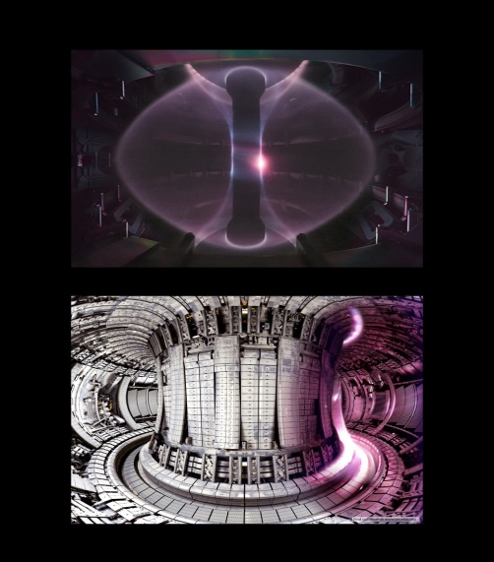
Tokamak data mirror for JET and MAST Moving towards an open data repository for European nuclear fusion research

Slide 2
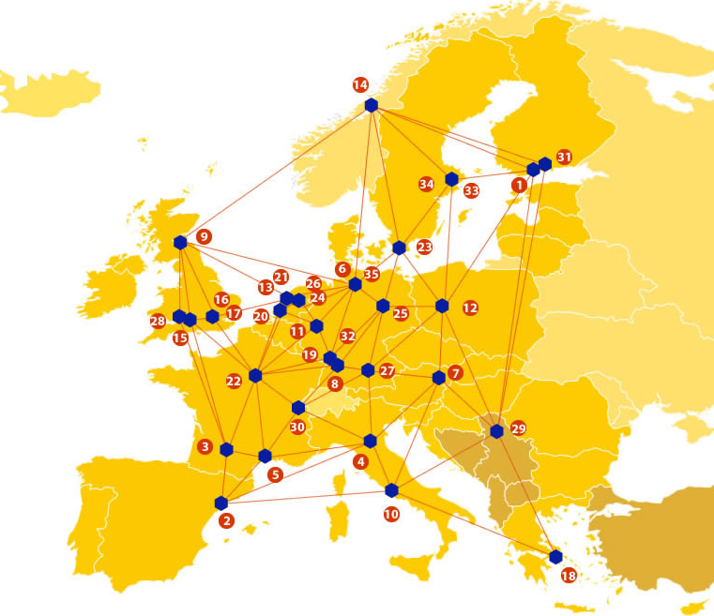

EUDAT: A truly pan-European Infrastructure
EUDAT offers common data services to both research communities and individuals through a network of 35 European organisations.
EUDAT wants to enable European researchers from any discipline to preserve, find, access, and process data in a trusted environment, as part of a Collaborative Data Infrastructure.
European infrastructures
Technology Providers
Research Communities

Slide 3

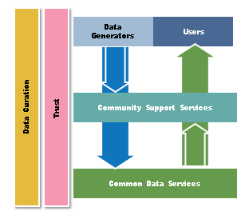
EUDAT Vision & Mission
Vision: Data is shared and preserved across borders and disciplines thereby enhancing the value and quality of research at large.
Mission: To enable data stewardship within and between European Research Communities through a Collaborative Data Infrastructure, a common model and service infrastructure for managing data spanning all European research data centres and community data repositories.

Slide 4
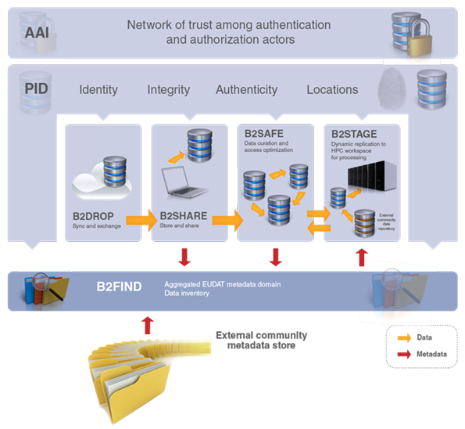














B2 Service Suite
Covering both access and deposit, from informal data sharing to long-term archiving, and addressing identification, discoverability and computability of both long-tail and big data, EUDAT services seek to address the full lifecycle of research data
https://www.eudat.eu/services
Notes:
B2FIND
stores metadata as well through other EUDAT services such as B2SHARE to provide access to data object within the EUDAT CDI
is used in inter-service use cases, e.g. to select links to data to be transferred to HPC platforms through B2STAGE

Slide 5






Building solutions with the communities
EUDAT services (B2 Service Suite) are designed, built and implemented together with user communities.
Common Language Resources and Technology Infrastructure (CLARIN)
European Network for Earth System Modelling (ENES)
Distributed infrastructure for life-science information (ELIXIR)
European Plate Observing System (EPOS) - Solid Earth sciences Research Infrastructure
Integrated Carbon Observation System (ICOS) to quantify & understand greenhouse gas balance
Long-Term Ecosystem Research (LTER) in Europe

Slide 6
The Challenge
Long running experiments, increasing data volumes
Data silos for each experiment – locally hosted, custom systems
Wish to make more use of standard data infrastructure (cloud-like platforms, modern APIs)
Simplify remote data access for EUROfusion partners to make more use of each other’s data
Piloting approaches for ITER - next generation fusion device will produce around a PB/day

Slide 7


Pilot Overview
CCFE operates two magnetic confinement nuclear fusion devices (Tokamaks)
Mega Amp Spherical Tokamak (MAST)
Joint European Torus (JET)
The pilot aims to:
Create a live mirror of JET and MAST experimental data, handling
Versioning
Quality markers
Access policy
Provide a convenient way to move experimental data to HPC centres
Cache synchronisation
Provenance

Slide 8
EUDAT Service Uptake
Multi-disciplinary joint metadata catalogue – B2FIND will be used for data discovery. We aim to provide improved meta-data such as aliases or tags for commonly used signals to help users who aren’t familiar with the machine-specific signal names.
Repository for shareable digital objects - will be used to provide on-demand access to individual data items via APIs. We will collaborate with EUDAT developers to address some of the challenges around data structure, versioning and access controls.
Data replication and long term preservation- B2SAFE will be used for resilient data storage. This will improve the redundancy of our data management infrastructure and allow bundles of data to be downloaded for particular purposes.
Data staging service - B2STAGE will be used to test shipping data sets between EUDAT storage sites and HPC clusters at Harwell (UK) and CINECA (Italy). This will reduce the need to create and move data bundles manually which can be difficult to manage and break the provenance chain.

Slide 9

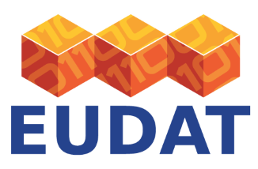

Contact
EUDAT
Web – eudat.eu
Twitter - @EUDAT_EU
Alys Brett
CCFE, UK
alys.brett@ccfe.ac.uk

